Slide 1

Reinforcement Learning & Reinforcement Learning from Human Feedback
Invited Lecture
ANAIS 5th Edition
4 January 2025
Manoj Shakya
Kathmandu University

Slide 2
Outline
Overview of Reinforcement Learning
Markov Decision Processes
Core concepts
Value functions: State-value and Action-value
Bellman Equation
Exploration vs. Exploitation
RL Algorithm
Q-Learning
Deep Reinforcement Learning
Reinforcement Learning from Human Feedback
Q/A session

Slide 3
Learning Objectives
Understanding the fundamentals of Reinforcement Learning
Familiarize with Markov Decision Processes (MDPs)
Know about the Bellman Equation
Basics of Reinforcement Learning from Human Feedback

Slide 4
Reinforcement Learning

Slide 5
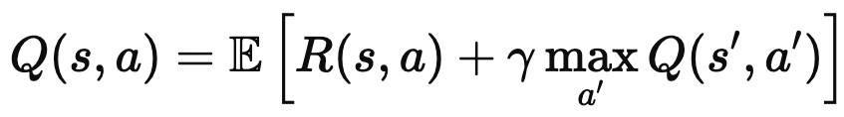
Bellman Equation for Q-value function Q(s, a)

Slide 6
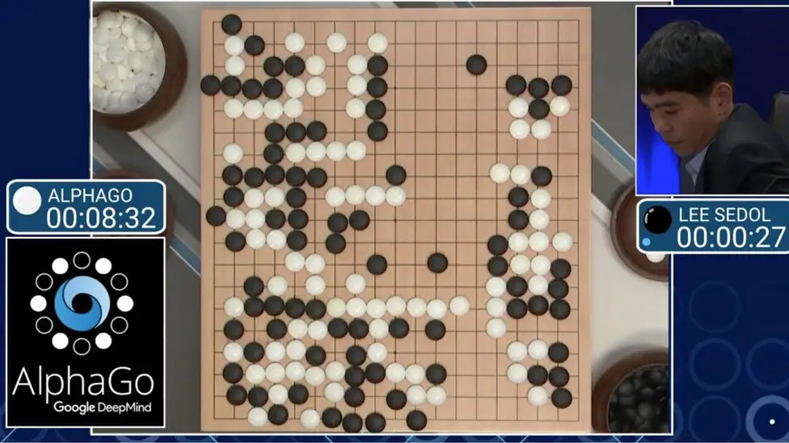
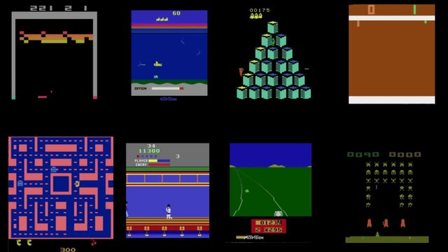
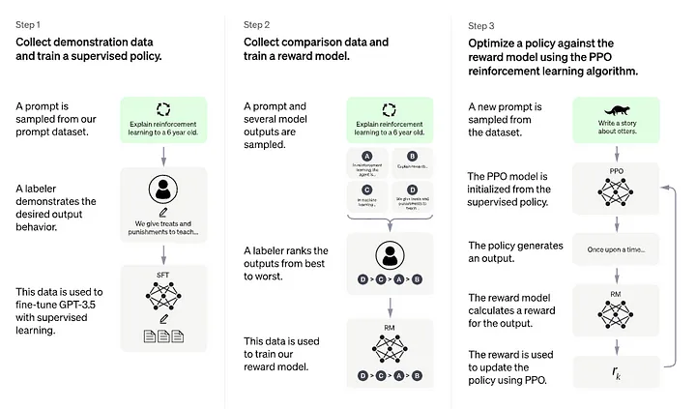
Overview of Reinforcement Learning

Slide 7
Reinforcement Learning
Agent
Environment

Slide 8
Reinforcement Learning
Agent
Environment
State s_{t}

Slide 9
Reinforcement Learning
Action a_{t}
Agent
Environment
State s_{t}

Slide 10
Reinforcement Learning
Action a_{t}
Agent
Environment
Reward r_{t}
State s_{t}

Slide 11
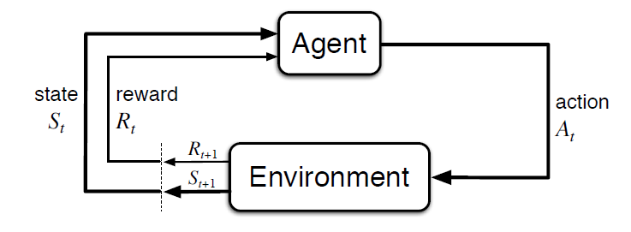
Overview of Reinforcement Learning
Source: http://incompleteideas.net/book/bookdraft2018jan1.pdf

Slide 12
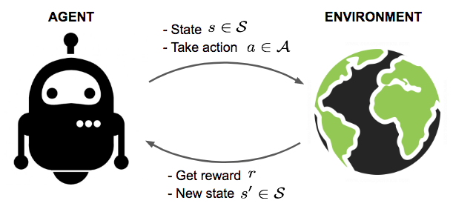
Overview of Reinforcement Learning
Source:https://lilianweng.github.io/posts/2018-02-19-rl-overview/

Slide 13
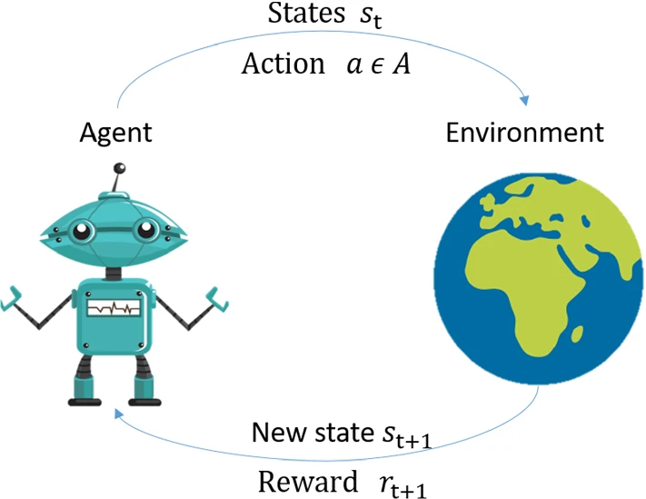
Overview of Reinforcement Learning
Source:https://link.springer.com/article/10.1007/s10462-022-10224-2

Slide 14
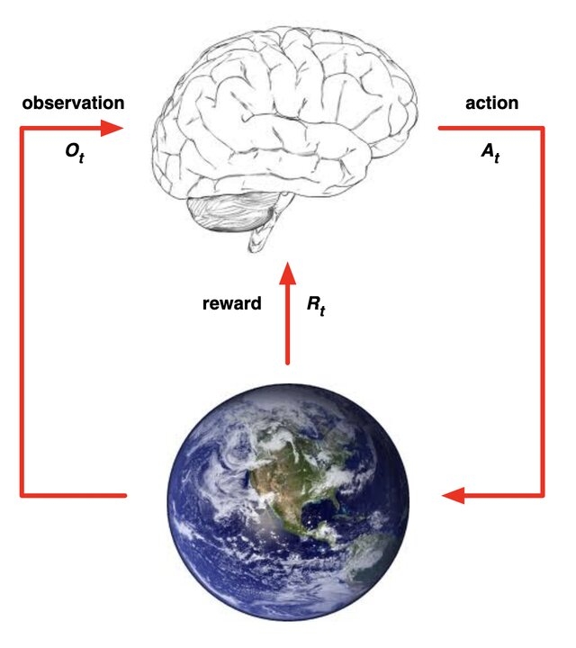
Overview of Reinforcement Learning
Source: https://www.davidsilver.uk/wp-content/uploads/2020/03/intro_RL.pdf

Slide 15
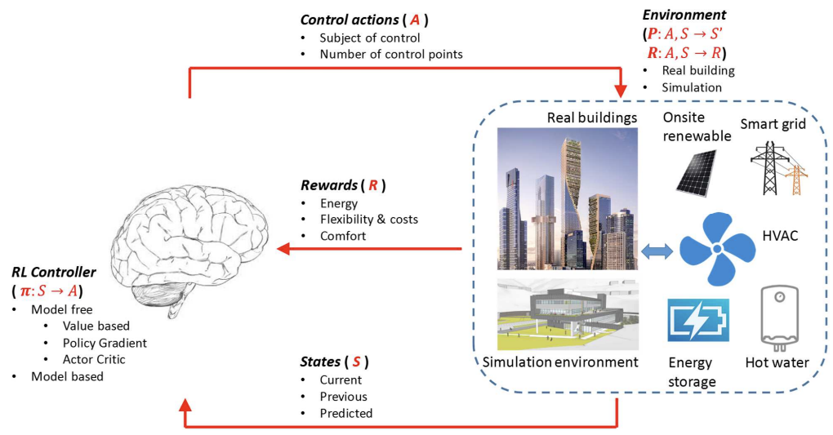
Overview of Reinforcement Learning
Source: https://www.sciencedirect.com/science/article/am/pii/S0306261920305481

Slide 16
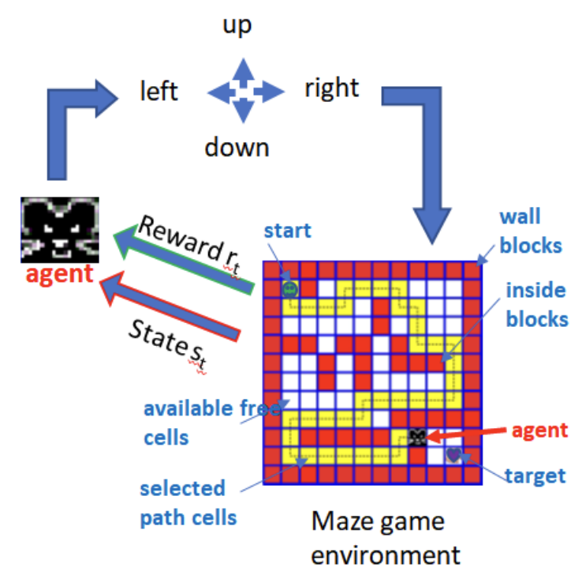
Overview of Reinforcement Learning
Source: https://scholar.smu.edu/cgi/viewcontent.cgi?article=1140&context=datasciencereview

Slide 17
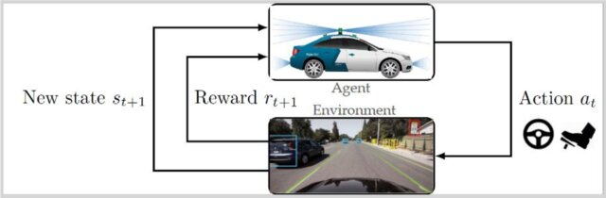
Overview of Reinforcement Learning
Source: https://www.ewadirect.com/proceedings/ace/article/view/9974

Slide 18
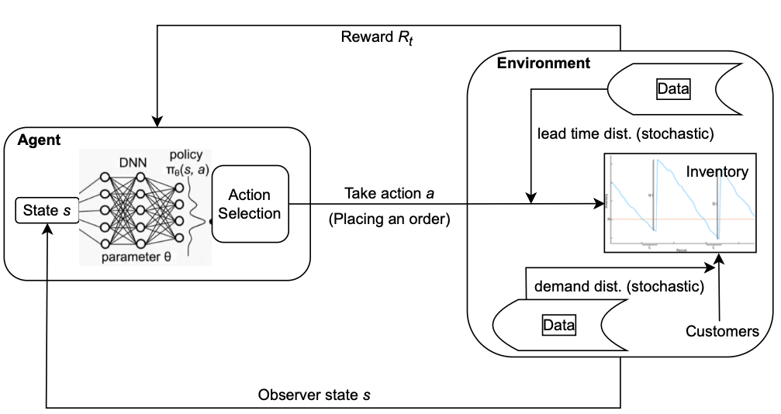
Overview of Reinforcement Leanring

Slide 19
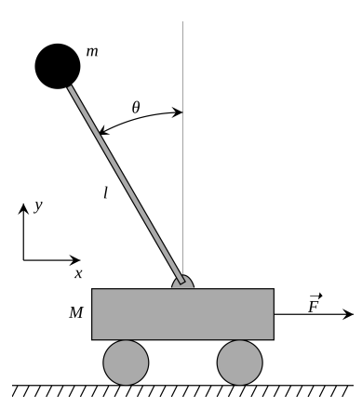
Cart-Pole Problem
Objective: Balance a pole on top of a movable cart
State: angle, angular speed, position, horizontal velocity
Action: horizontal force applied on the cart
Reward: 1 at each time step if the pole is upright
Source: https://cs231n.stanford.edu/slides/2017/cs231n_2017_lecture14.pdf

Slide 20
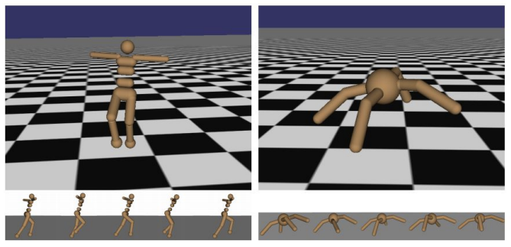
Robot Locomotion
Objective: Make the robot move forward
State: Angle and position of the joints
Action: Torques applied on joints
Reward: 1 at each time step upright + forward movement
Source: https://cs231n.stanford.edu/slides/2017/cs231n_2017_lecture14.pdf

Slide 21
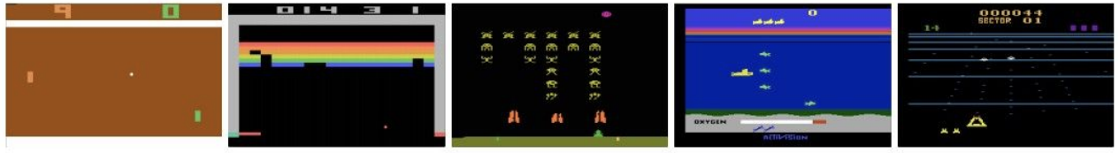
Atari games
Objective: Complete the game with the highest score
State: Raw pixel inputs of the game state
Action: Game controls e.g. Left, right, Up, and Down
Reward: Score increases/decreases at each time step
Source: https://cs231n.stanford.edu/slides/2017/cs231n_2017_lecture14.pdf

Slide 22
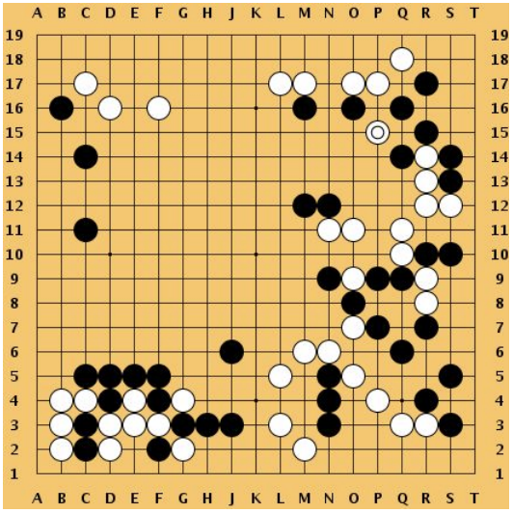
Go
Objective: Win the game!
State: Position of all pieces
Action: Where to put the next piece down
Reward: 1 if win at the end of the game, 0 otherwise
Source: https://cs231n.stanford.edu/slides/2017/cs231n_2017_lecture14.pdf

Slide 23
Markov Decision Process

Slide 24
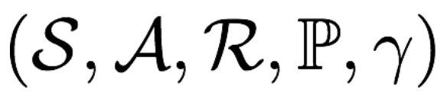




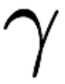
Markov Decision Process
Mathematic Formulation of the RL problem
Markov property: Current state completely characterizes the state of the world
Defined by:
: set of possible states
: set of possible actions
: distribution of reward
: transition probability
: discount factor
Source: https://cs231n.stanford.edu/slides/2017/cs231n_2017_lecture14.pdf

Slide 25
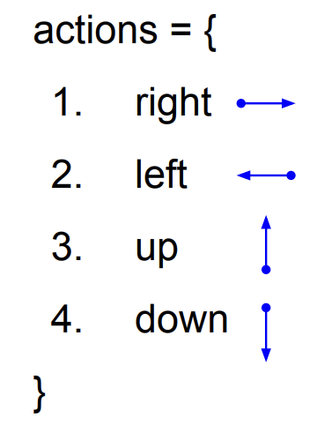
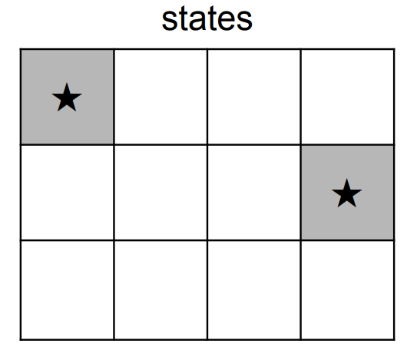
A simple MDP: Grid Example
Set a negative “reward” for each transition
(e.g. r = -1)
Source: https://cs231n.stanford.edu/slides/2017/cs231n_2017_lecture14.pdf

Slide 26
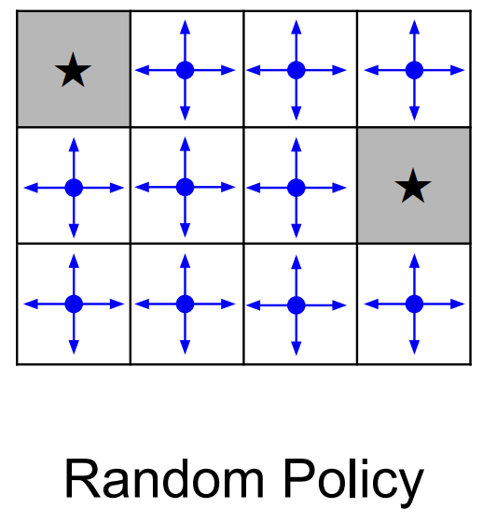
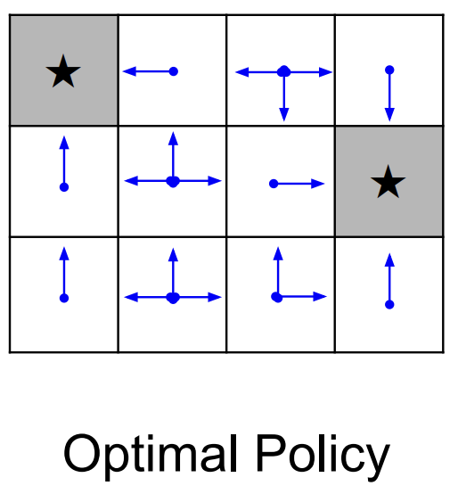
A simple MDP: Grid Example
Source: https://cs231n.stanford.edu/slides/2017/cs231n_2017_lecture14.pdf

Slide 27
Core Concepts

Slide 28
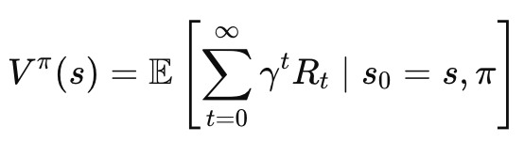
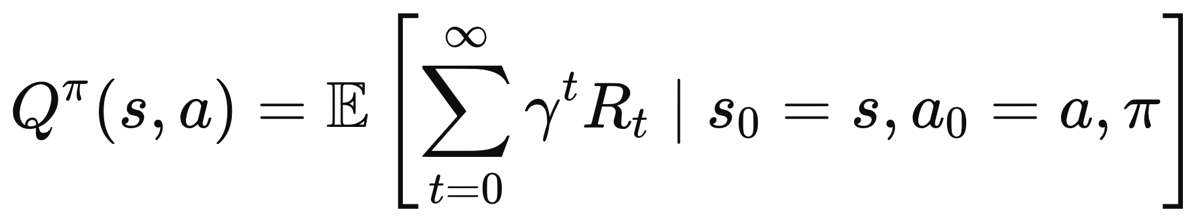
Value functions
The value function is a critical concept that quantifies how good it is for an agent to be in a given state or to take a specific action in that state.
Types:
State Value Function: The value function at state s, is the expected cumulative reward from following the policy from state s:
Action Value Function: The Q-value function at state s and action a, is the expected cumulative reward from taking action a in state s and then following the policy:

Slide 29
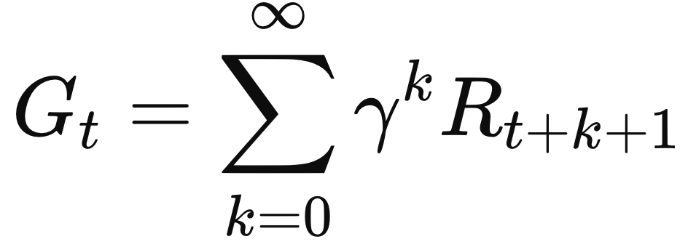
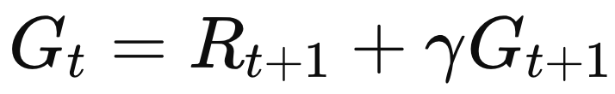
Rewards
A scalar feedback signal received from the environment
Indicates the immediate success or failure of the agent's action in a given state
The agent's goal is to maximize the cumulative reward over time.

Slide 30
Derivation of Bellman Equation
Substitute G_{t} into the Value Function:
Express G_{t+1}​ Using the Value Function:

Slide 31
Bellman equation

Slide 32
Exploitation vs Exploration

Slide 33
Exploitation vs. Exploration
In RL, the environment is initially unknown. How to act optimal?
Exploitation: leverage known information to maximize immediate rewards
Exploration: Involves the agent taking actions that may not necessarily yield immediate rewards
Trade-off: Too much exploitation can lead to suboptimal policies due to insufficient exploration, while excessive exploration can result in wasted resources and time without gaining useful information.
Regret-Minimization: Effective exploration strategies aim to minimize regret, which is the difference between the rewards obtained through a chosen policy and the maximum possible rewards that could have been achieved.

Slide 34
Exploitation vs. Exploration (Examples)
Restaurant Selection
Exploitation: Go to your favourite restaurant
Exploration: Try a new restaurant
Online Banner Advertisements
Exploitation: Show the most successful advert
Exploration: Show a different advert
Oil Drilling
Exploitation: Drill at the best know location
Exploration: Drill at a new location
Game Playing
Exploitation: Play the move you believe is the best
Exploration: Play an experimental move
Source: https://www.davidsilver.uk/wp-content/uploads/2020/03/XX.pdf

Slide 35
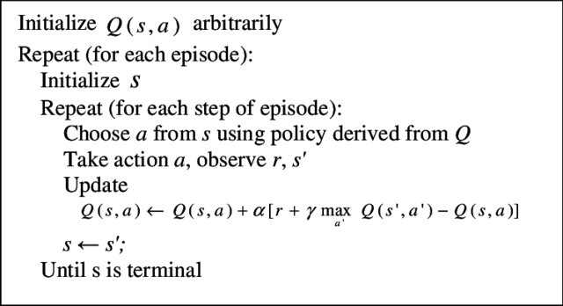
RL Algorithms (Q-Learning)

Slide 36
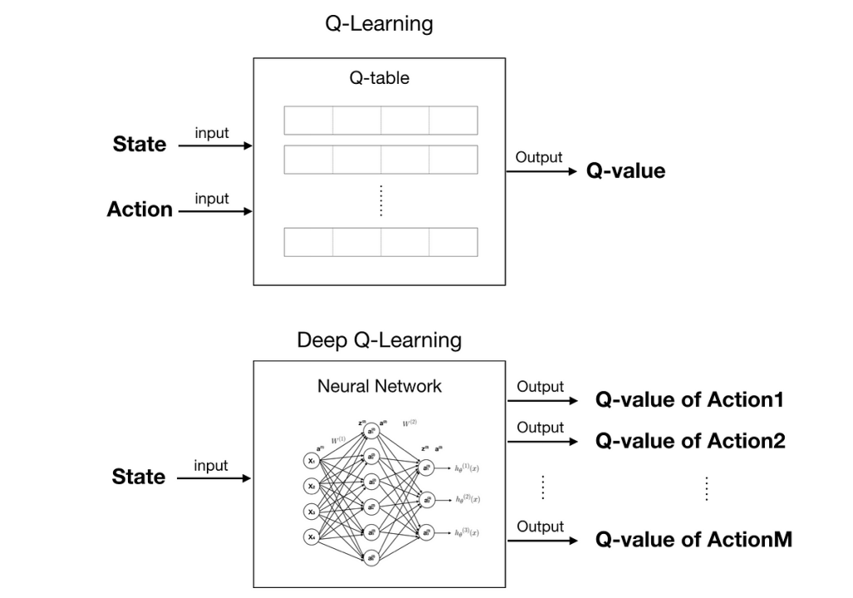
Deep Reinforcement Learning

Slide 37
Reinforcement Learning from Human Feedback (RLHF)

Slide 38
RLHF
Reinforcement Learning from Human Feedback (RLHF): A machine learning technique that incorporates human feedback into the AI training process.
Application Area: Primarily used in natural language processing (NLP) tasks.
Goal: Enhance the performance of AI systems and align them with human values and preferences.

Slide 39
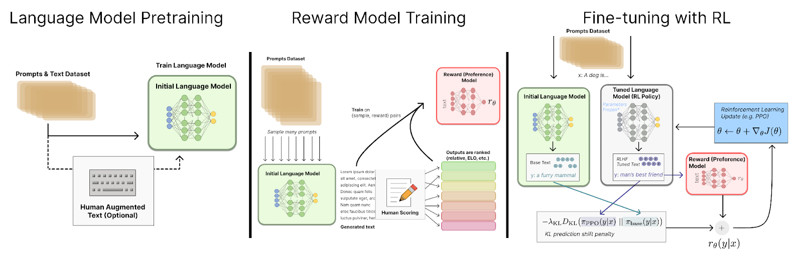
RLHF Overview
Source: An introduction to Reinforcement Learning from Human Feedback (RLHF) by Nathan Lambert

Slide 40
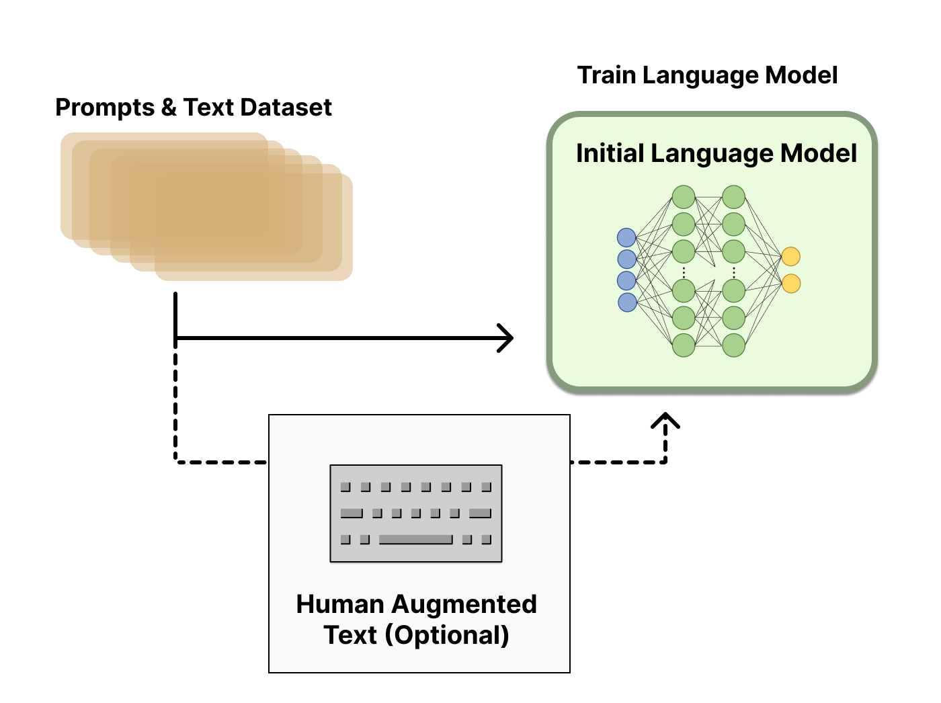
Language model pretraining
Common training techniques in NLP:
- Unsupervised sequence prediction
- Data scraped from web
- No single answer on “best” model size (examples in industry range 10B-280B parameters)
Dataset:
- Reddit, other forums, news, books - Optionally include human-written text from predefined prompts
Source: An introduction to Reinforcement Learning from Human Feedback (RLHF) by Nathan Lambert

Slide 41
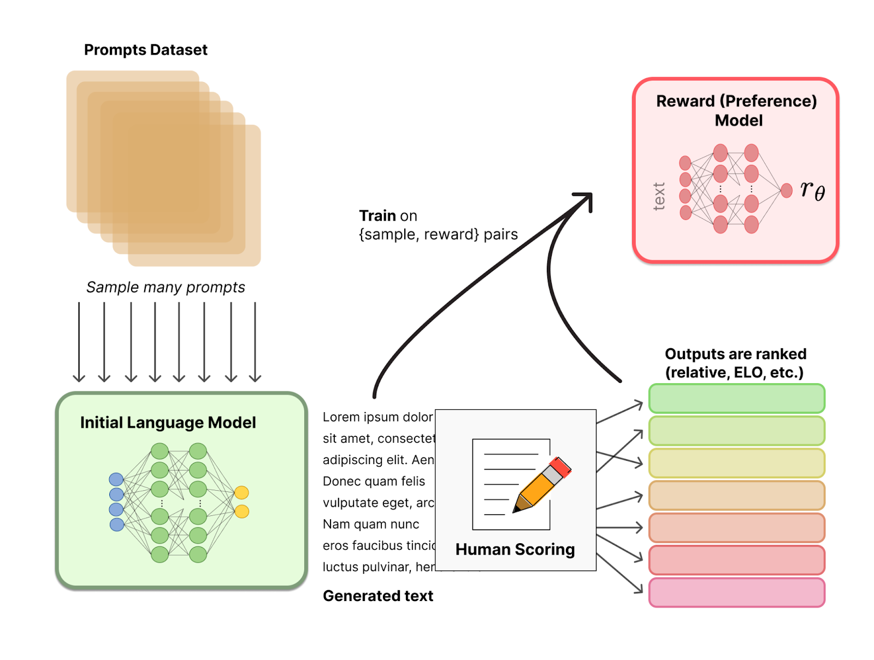
Reward model training
How to capture human sentiments in samples and curated text? What is the loss!
Goal: get a model that maps
input text → scalar reward
Source: An introduction to Reinforcement Learning from Human Feedback (RLHF) by Nathan Lambert

Slide 42
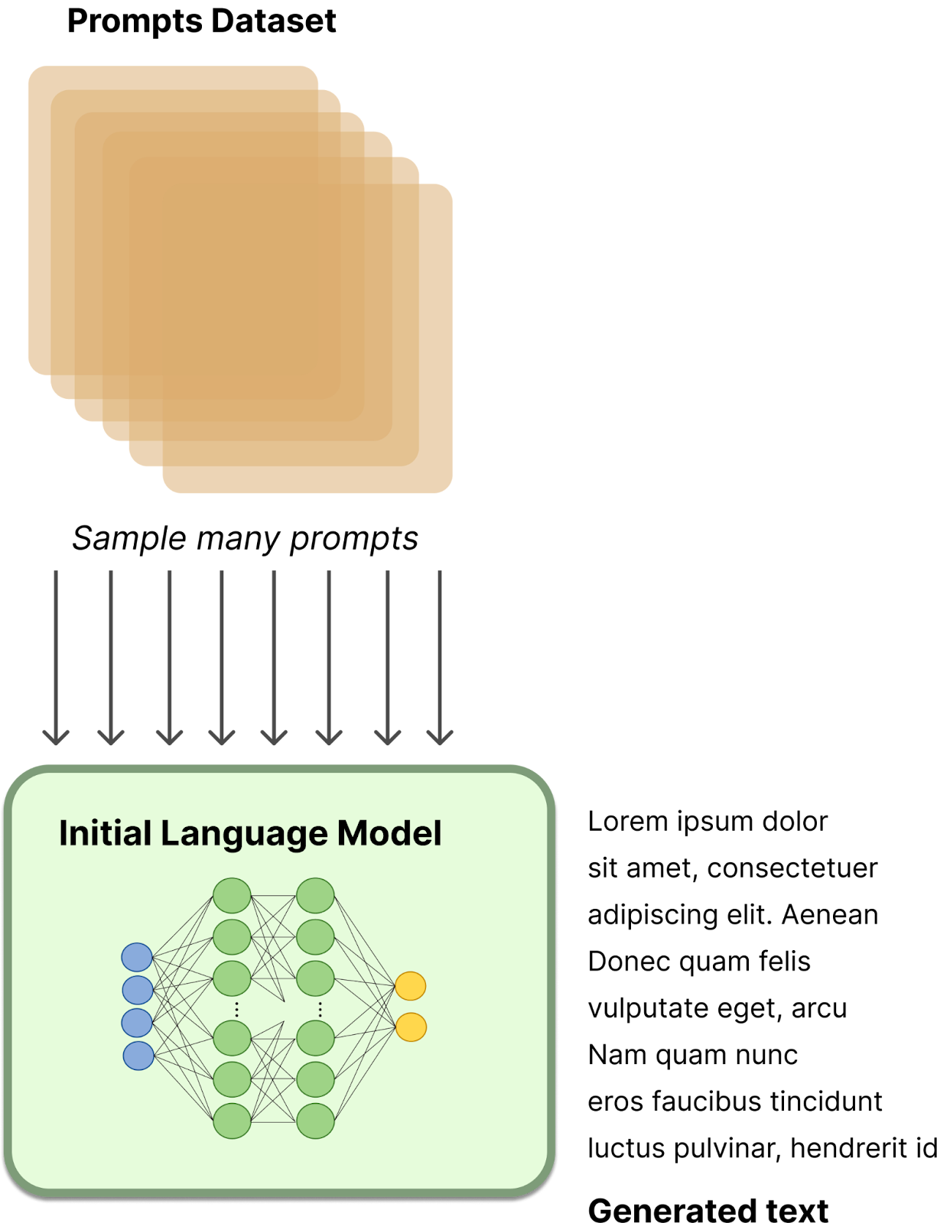
Reward model training
Prompts (input) dataset: - Prompts for specific use-case model will be used for
- E.g. chat questions or prompt-based data
- Much smaller than original pretraining!
Source: An introduction to Reinforcement Learning from Human Feedback (RLHF) by Nathan Lambert

Slide 43
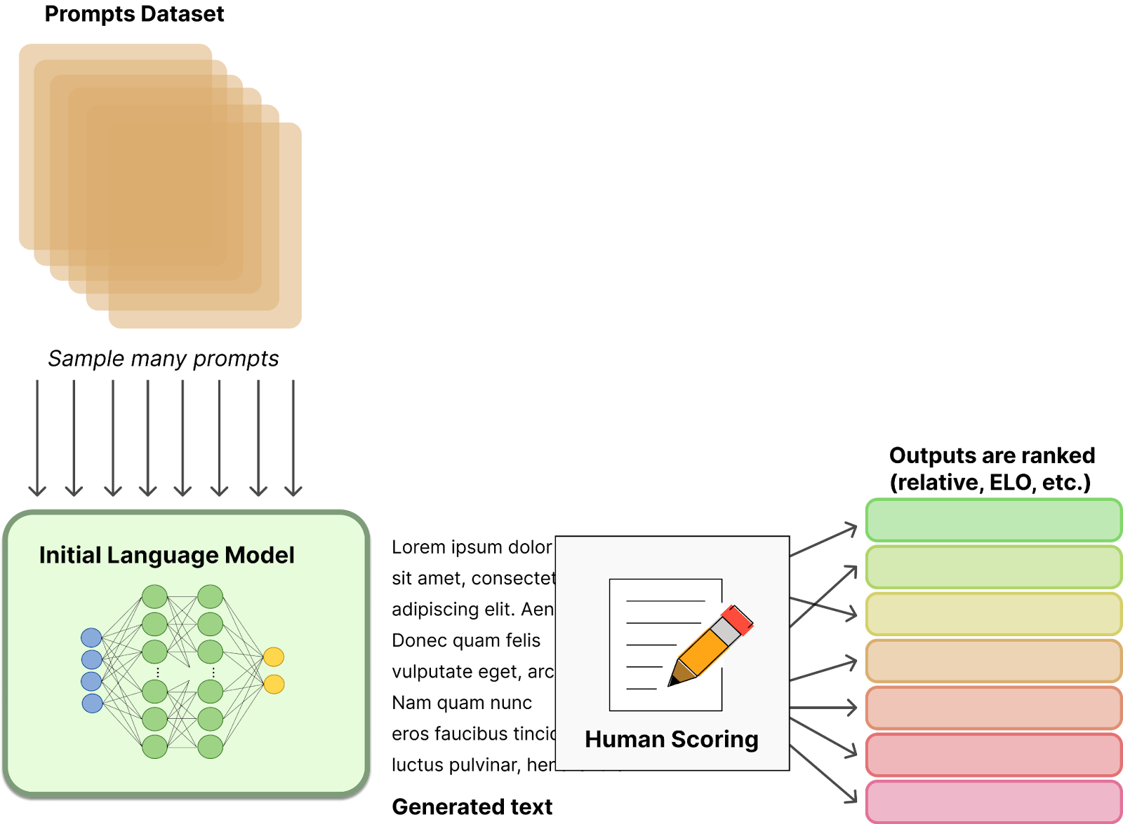
Reward model training
Source: An introduction to Reinforcement Learning from Human Feedback (RLHF) by Nathan Lambert

Slide 44
Reward model training
Source: An introduction to Reinforcement Learning from Human Feedback (RLHF) by Nathan Lambert

Slide 45
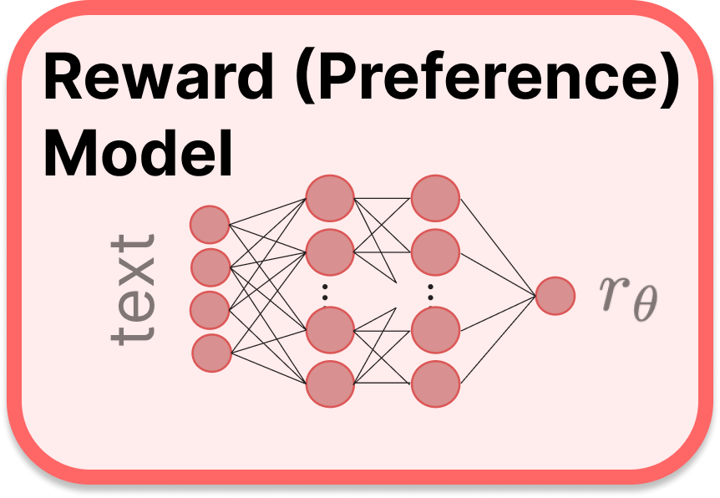
Reward model training
Reward model:
- Also transformer based LM
- Variation in sizes used (relative to policy)
- Outputs scalar from text input
Source: An introduction to Reinforcement Learning from Human Feedback (RLHF) by Nathan Lambert

Slide 46
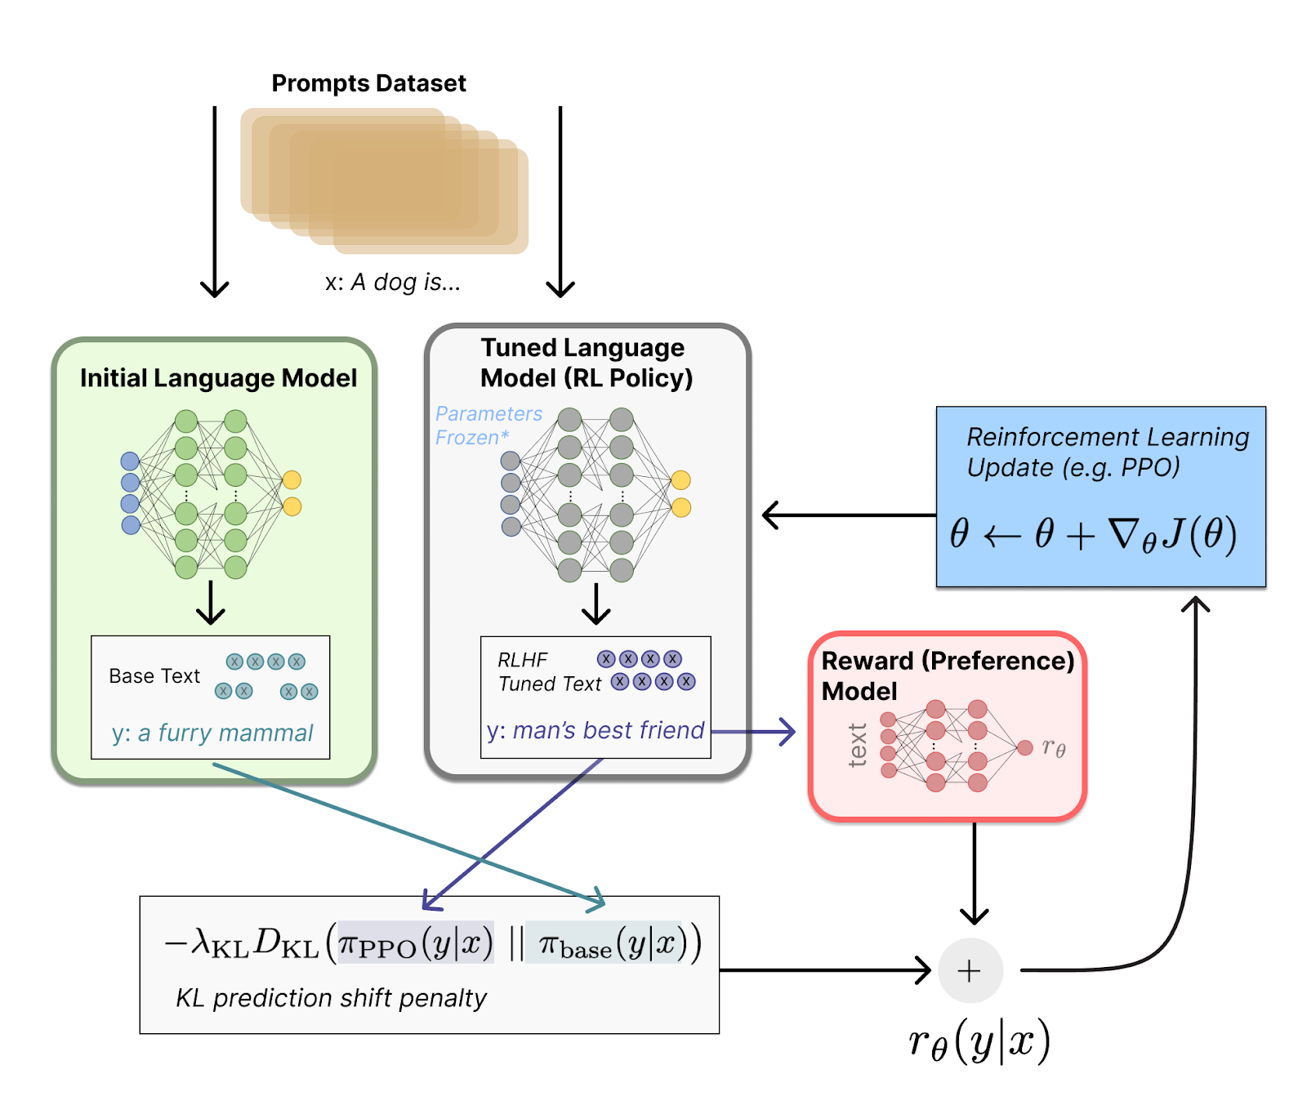
Fine tuning with RL

Slide 47
RLHF Overview
Source: An introduction to Reinforcement Learning from Human Feedback (RLHF) by Nathan Lambert

Slide 48
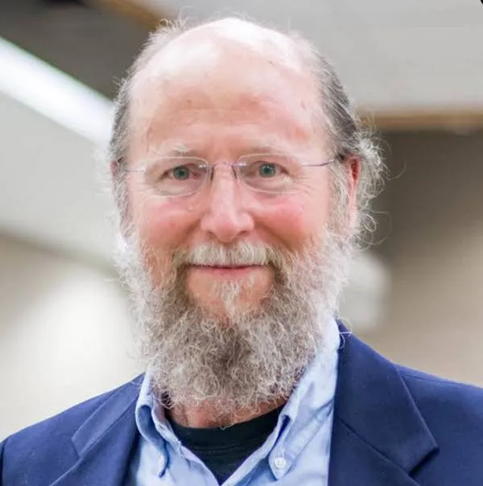
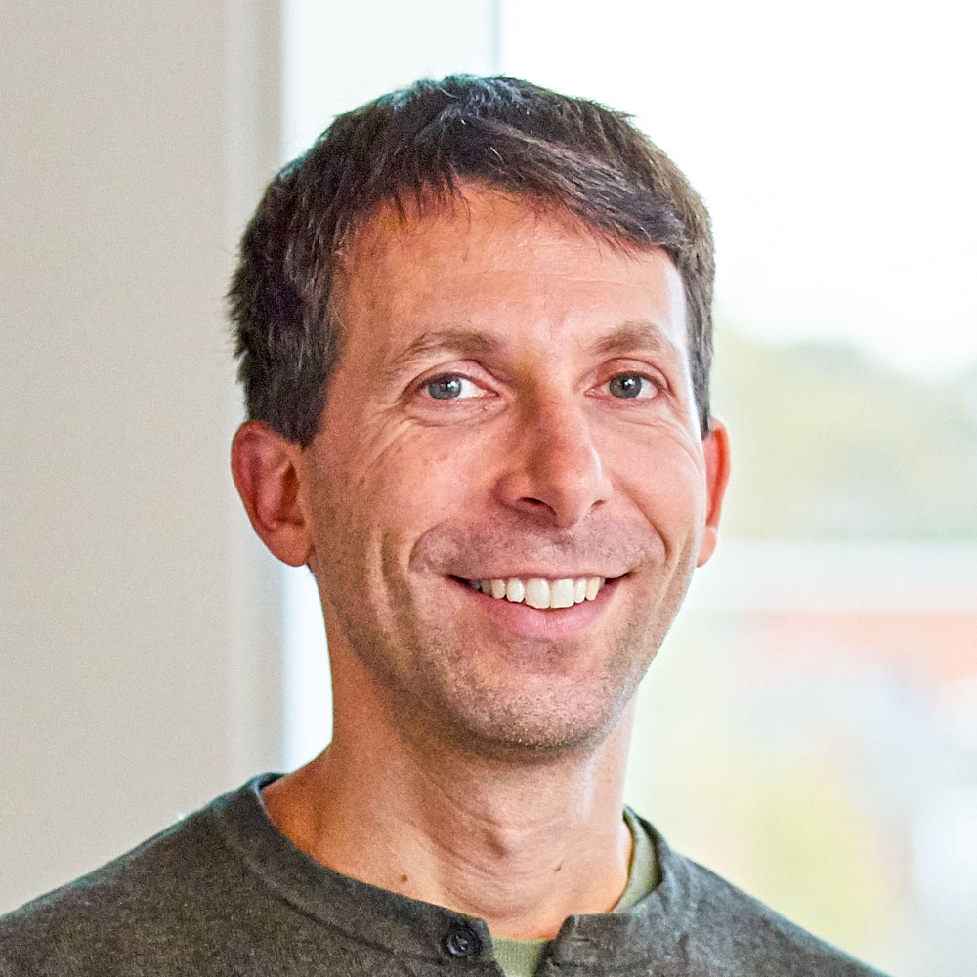
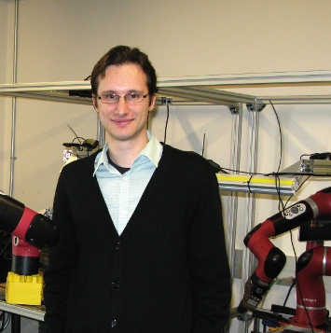

Reinforcement learning | Great Contributors

Slide 49
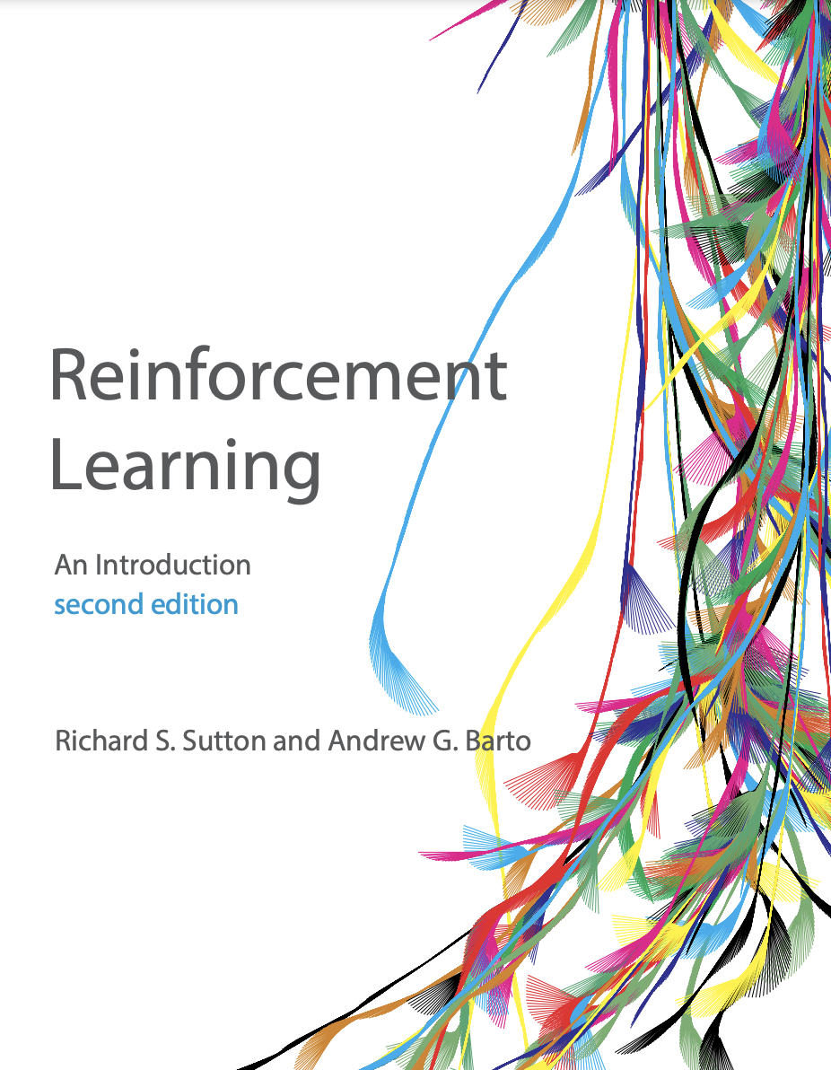
Textbook

Slide 50
Q/A
Reinforcement Learning
Reinforcement Learning with Human Feedback

Slide 51
Takeaways!?
manoj@ku.edu.np

Slide 52
Thank you!
manoj@ku.edu.np

